Slide 1


Title I Annual Parent Meeting
Bardmoor Elementary
8/31/2022
6:00 PM
Leigh L. Brown
Notes:
Evidence: Upload completed presentation and recorded feedback as part of the evidence to support the Annual Meeting Materials. Do not forget the sign-in sheets, and survey/feedback that you receive throughout the meeting.

Slide 2

Education, then, beyond all other divides of human origin, is a great equalizer of conditions of men.”
– Horace Mann
Notes:
“Education, then, beyond all other divides of human origin, is a great equalizer of conditions of men.” – Horace Mann

Slide 3

All About Title I
Title I is the largest federal assistance program for our nation’s schools.
Title I is the largest federal assistance program for our nation’s schools.
The program serves 75 schools in Pinellas County including eligible students in 36 non-public schools.
Notes:
Highlight the Title I Program here in Pinellas County.

Slide 4
Title I Funding Process
Pinellas County Schools
Increased Student Achievement
Federal Government
1
3
2
4
Florida Department of Education
Bardmoor Elementary
Notes:
The Florida Department of Education receives funds from the federal government. Districts receive Title I funds from Department of Education, and the school district distributes these funds to schools based on the percentage of children eligible for free/reduced price lunch; however, students do not have to be from low-income families to receive help.

Slide 5

Supplemental Resources
Definition: provided in addition to what is already present or available to complete or enhance it.
https://languages.oup.com/
Notes:
Title I is supplemental federal funding that provides e
Definition: provided in addition to what is already present or available to complete or enhance it extra academic support and learning opportunities for economically disadvantaged students.

Slide 6
Title I Programs Provide Supplemental Support
  At Bardmoor Title I provides
  Hourly teachers to work with students in reading and math
  MTSS coach
  Full time social worker
  Curriculum materials
  Reading interventions for struggling students
  Family engagement workshops
Notes:
Use additional slides if necessary. This is where you want to really highlight Title I funding and how it positively impacts your scholars!
Additional supplemental personnel (add specific positions)
Additional training opportunities for school staff (add specific trainings offered at your site)
Extended Learning Opportunities (before and/or after school programs)
Supplemental teaching materials, equipment, and technology
Parent and Family Engagement Resources and Training Workshops

Slide 7
Title I Schoolwide Planning and Input
First
Second
Last
Seek Input from school, family, and community members determine how Title I funds are used based on a needs assessment.
Please attend online or in-person meetings/trainings and complete surveys to provide input on Title I funding.
All Title I schools must document that parents are involved in the schoolwide planning process.
Notes:
Evidence for input – input from school can be a survey or notes, which include quotes related to what was shared as feedback AND how this input will be used to inform the PFEP and future engagement activities.
Evidence of Attendance – please include attendance of DIVERSE stakeholder group/s.

Slide 8

Title I Schoolwide Budget
Total Allocation 180,150
Personnel 64% (including hourly teachers, MTSS coach, School Social worker -119,282
Professional Development 2% 3,850.00
Curriculum Development and Coordination 34% 62,947
supplemental Instructional Materials and Resources 1% 2,546

Slide 9

Parent’s Right to Know
As a parent of a student attending a Pinellas County School Public School, you have the right to…
Be
Be provided information on your child’s level of achievement on assessments in Reading/Language Arts, Writing, Mathematics, and Science.
Request and Receive
Request and receive information on the qualifications of your child’s teacher and supplemental personnel working with your child.
Be
Be notified of non-highly qualified or out-of-field teachers at the school.
Be
Be informed if your child is taught by a non-highly qualified teacher for four or more consecutive weeks.

Slide 10
Working Together for Student Success
As a Title I parent you have the right to be involved in the development of the following plans and documents for our school which can be found on our website (insert website) to view as well as in the Parent Station located front office.
School Improvement Plan (SIP)
Title I Schoolwide Plan
Parent and Family Engagement Plan (PFEP)
School-Parent-Student Compact
Notes:
Our school’s Title I Parent Station is located (insert location or photo of Title I Parent Station (front office and on the webpage). Please include photo as part of the evidence monitoring.
You will find a copy of our School Improvement Plan, Title I Schoolwide Plan, School’s PFEP, the School District’s PFEP, Parent’s Right to Know Memo, Upcoming Events, Compact, (insert other documents at your station)

Slide 11

Parent-School-Student Compact
The purpose of the compact is to foster student achievement. By signing the Parent-School-Student Compact, (Insert name of school here), teachers, staff, parents and students agree to work together to share the responsibility of helping students meet or exceed state, district and school academic goals.
The Parent-School-Student Compact is updated every year to include parent, student, teacher, and staff input. Parent, student, teacher and staff comments are welcome at any time during the year.
Please review and sign your child’s Compact.
Our goal is to receive 100% signed compacts!
Notes:
At the elementary level, school compacts are used as a progress monitoring tool through the year during parent teacher conferences.

Slide 12
Sample School Compact
Insert school compact
Notes:
Highlight any things that unique to your school’s compact.

Slide 13

Parent and Family Engagement Plan (PFEP)
The PFEP Sections include information about the following:
  Parent trainings to increase student achievement
  Staff trainings for engaging parents
  Communication methods between home and school
  Flexible meeting times
  Accessibility for parents
  Coordinating with other Federal Programs
Notes:
Provide information on the specific committees that parents can be involved. Include the purpose, date and time of meetings.
Explain the PFEP and its purpose.
Consider the evidence related Title I Crate, Sample of Evidence,

Slide 14
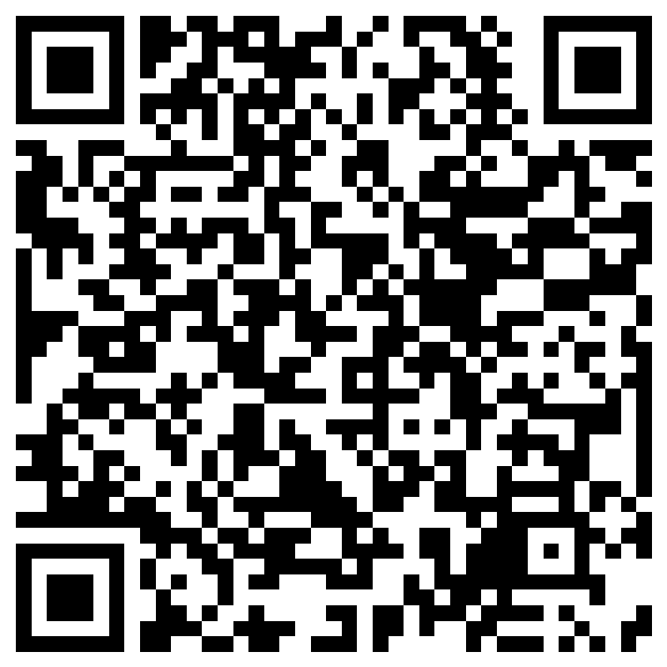
Parent Advisory Council (PAC) Interest Form
Notes:
Please complete the form if you are interested in representing your school/community.
Please allow a minute for interested families to complete the form during the meeting.
Here is the link for you to share also: https://forms.office.com/r/XYv54tECMy

Slide 15


Shift to New B.E.S.T. Standards
Notes:
All curriculum, instruction and assessments are based on student-centered expectations.
FSA → Transition to BEST!
https://www.flgov.com/2021/09/14/governor-desantis-announces-end-of-the-high-stakes-fsa-testing-to-become-the-first-state-in-the-nation-to-fully-transition-to-progress-monitoring/

Slide 16


Florida Benchmark For Excellent Student Thinking Standards (B.E.S.T). You may read more information by visiting, http://www.fldoe.org/standardsreview/
Notes:
All curriculum, instruction and assessments are based on student-centered expectations.

Slide 17

New Assessment: FAST
More information can be found about the FSA Transition to FAST:
https://feaweb.org/fsa-transition-to-fast/
Source: https://www.flgov.com/2021/09/14/governor-desantis-announces-end-of-the-high-stakes-fsa-testing-to-become-the-first-state-in-the-nation-to-fully-transition-to-progress-monitoring/

Slide 18

We appreciate your time!
Please feel free to ask any questions and provide feedback on our Title I Program.

Slide 19
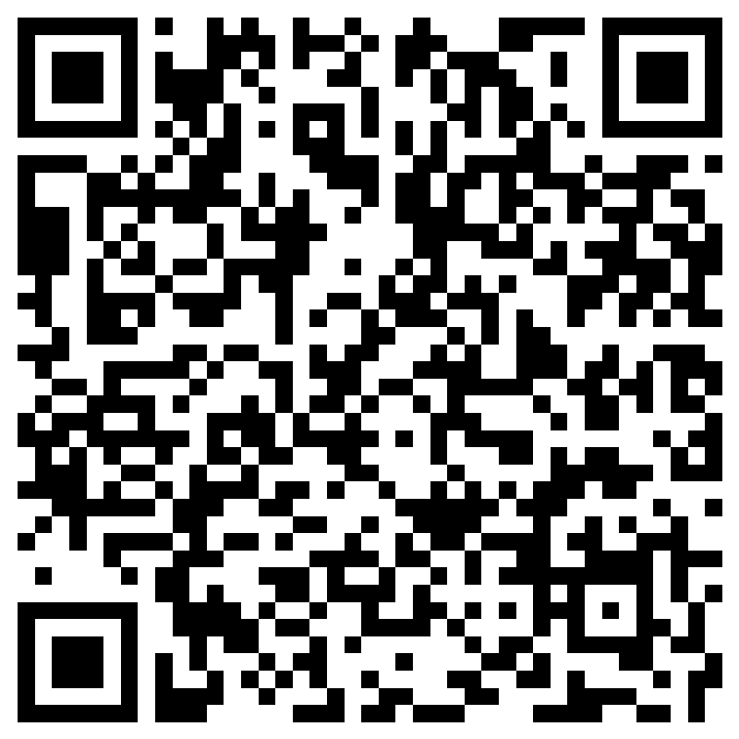
Please take the time to participate in our survey.
Your feedback is greatly appreciated!
Notes:
Please duplicate Microsoft Forms provided or create school survey. To generate a QR code hover over your school’s survey and and right click. Create QR code for this page will be an option.
https://forms.office.com/Pages/ShareFormPage.aspx?id=BZM8c9c5GkaGb_3ye_PH_x-1YNVO6C1FkgA88U6PR2tUNEQzTU0wNkZXVUxVTlpEMU81NkJFMlJNTi4u&sharetoken=FXXhmgwFjSnl0sNz61ki

